Slide 1
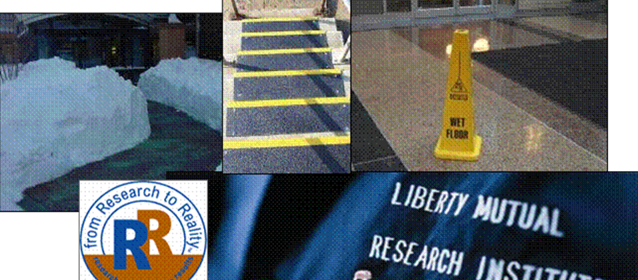
Preventing Slips, Trips, Falls (STF)

Slide 2
Do’s
Actively participate by contributing
  Ask questions
  Share experiences
  Request explanations
Be supportive of your co-workers
Apply what you learn to your job
Pass on the information
Notes:
Notes to Instructor/Facilitator
Here are some basic points to set the tone for the meeting. Expand as needed.
______________________
Discussion Leader’s Notes:
Here are some guidelines for the way we will conduct this meeting:
DO
Ask a question when you have one.
Feel free to share an illustration or personal experiences.
Request an example if a point is not clear.
Actively participate – there’s no such thing as a silly question, particularly when talking about safety.
Support your co-workers. Be courteous and encouraging as they offer input to this meeting.
Search for ways in which you can apply this general principle or idea to your work environment. Turn this knowledge into know-how.
Pass on information learned here to your subordinates or any co-workers who have not attended this session.

Slide 3
Objectives
Explain the significance of slips, trips and falls.
Identify causes and contributing factors that lead to slip, trip and fall accidents.
Apply a process for the prevention of slips, trips and falls.
Implement appropriate corrective action.
Notes:
Notes to Instructor/Facilitator
As discussion leader, emphasize the extent of the fall problem in the workplace, basic causes of falls inside and from heights, and control techniques.
______________________
Discussion Leader’s Notes:
As a result of attending this session you will be able to:
• Explain the significance of slips, trip and falls. Same level falls are a leading loss area in nearly every industry both workplace and to the public
• Identify causes and contributing factors. Causes of slips, trips and falls involve multiple disciplines but understanding causes is very important to prevention.
• Apply a process for prevention which we will call the slip, trip and fall continuum.
• Implement corrective action. Based on the slip, trip and fall continuum, we will provide you guidelines on how to identify opportunities to improve your slip, trip and fall program.

Slide 4
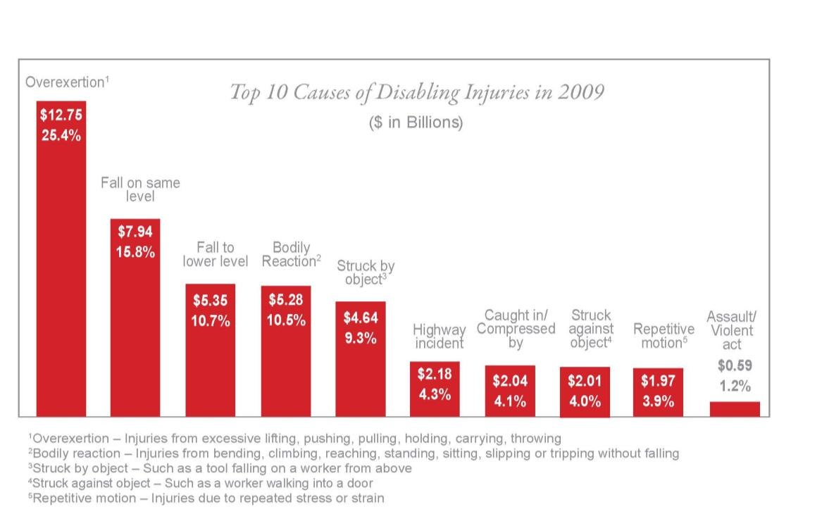
2011 Liberty Mutual Workplace Safety Index

Slide 5
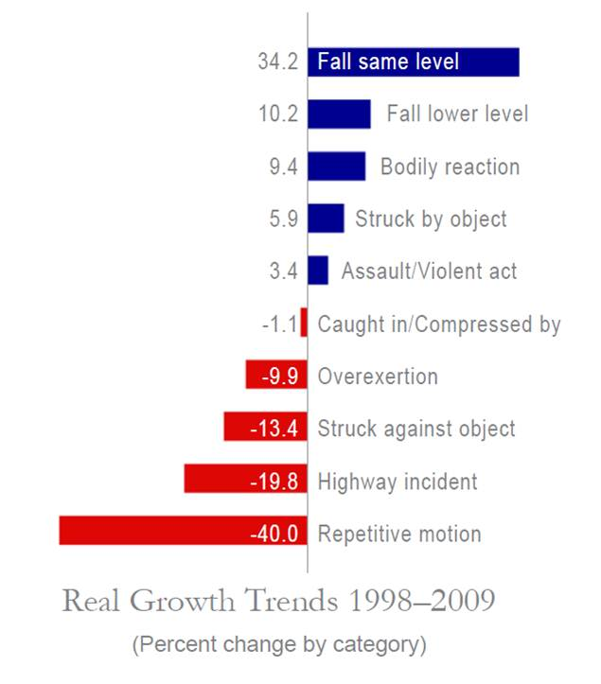
Percentage of Real Growth
Notes:
Notes to Instructor/Facilitator
Discuss the increase in slips and falls injuries over the last ten years.
______________________
Discussion Leader’s Notes:
Overall, the real (inflation-adjusted) direct costs of disabling workplace injuries decreased 4.6 percent between 1998 and 2009 but direct costs for falls on same level have increased by over 34%; far more than other injury cause.

Slide 6
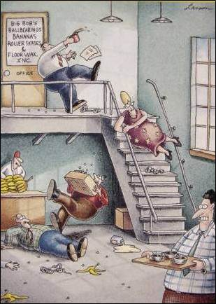
Causes of Slips, Trips and Falls
Tribology
Age and vision
  Transitions, “visually detectable”
Biomechanics
  Ambulation and gait
Psychology
  Perceptions of slipperiness
Others
Gary Larson’s The Farside®
Notes:
Causes of slips, trips and falls are complicated and involve multiple disciplines. Tribology is important to understanding slipperiness and we’ll discuss that in a moment. Impact of age and vision is very important especially with regards to visual detection of hazards. Major point to be made here is do not expect people to look down and detect hazards. Many of us have will trouble visually detecting those transitions particularly as we age. Plus, now we have distracted walking from people talking and texting with their phones, etc. If you want people to look down to detect a possible hazard, you must intentionally catch the eye. The way to do that is through color and contrast to make transitions more visually detectable using color like Safety Yellow, and/or contrasting colors both color and brightness
Biomechanics refers to the study of the anatomy and mechanics of movement in the human body. Ambulation and gait refer to movement primarily of the lower extremities during walking and are helpful in understanding slips and trips.
Regarding psychology, perception of slipperiness research has shown that humans are very different in heel slip distance and perception they are slipping, friction and perception of high traction floors and visual cue of a floor and whether it is slippery.
Examples of “Others” would be individuals on prescription drugs that impair cognition and balance, certain illnesses that affect vestibular system (inner ear) and other pedestrian medical issues you have no control over. This is why it is important to eliminate hazards when possible.
In conclusion: do not depend on humans to be safe, detect hazards and take precautions. Best approach is to eliminate or reduce hazards through facility design or overall proactive slip, trip and fall prevention programs. That is the purpose of today's session.

Slide 7
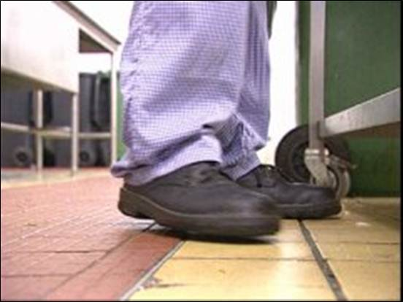
Tribology
The study of the interaction of sliding surfaces
It includes three subjects:
  Friction
  Lubrication
  Wear
Notes:
The discussion of slippery floors must consider the science of tribology. No, that is not a typo….it is not “tripology” but “tribology” which is a branch of mechanical engineering that deals with surfaces in motion and in contact with another. Three disciplines are involved; friction between those surfaces, lubrication film between those surfaces and wear of those surfaces. Tribology is important to describe how a slip occurs. So, in our application high friction means a high coefficient of friction (COF) which is a good thing. Lubricants mean added slipperiness of floors which is a bad thing. Wear considers wear of both the shoe outsole material/tread AND wear of the floor surface material and any grit materials over time. Both of these could impact floor slipperiness.

Slide 8
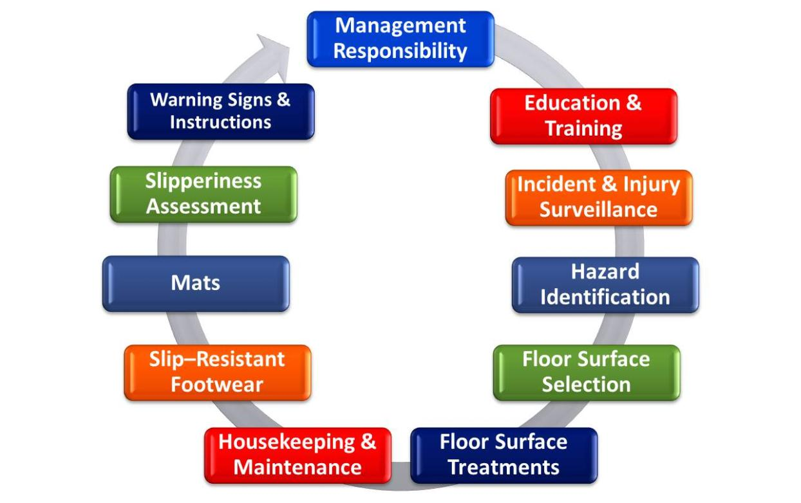
Slip, Trip and Fall Prevention Continuum
Notes:
The Slip, Trip Fall Continuum describes a proactive managed process for prevention that requires participation from everyone in the organization. This presentation will go around the continuum and address those items helpful to you. You can do any one of these items well but they must be done together for consistent and positive results. As we go through this presentation, think of those elements you do well and those you need to do better.
Without trying to finger point, there is an overall lack of knowledge of slip, trip and fall prevention by some architects, building designers and facility managers. The international building codes and federal government standards such as the ADA (discussed earlier) do not adequately address this issue at design and leave key decisions on “slip resistance” to the building designers assuming they have the necessary background knowledge of slip, trip and fall prevention. This a knowledge gap and is being addressed in prevention through design initiatives but as safety professionals we have an important role in training these critical stakeholders.

Slide 9
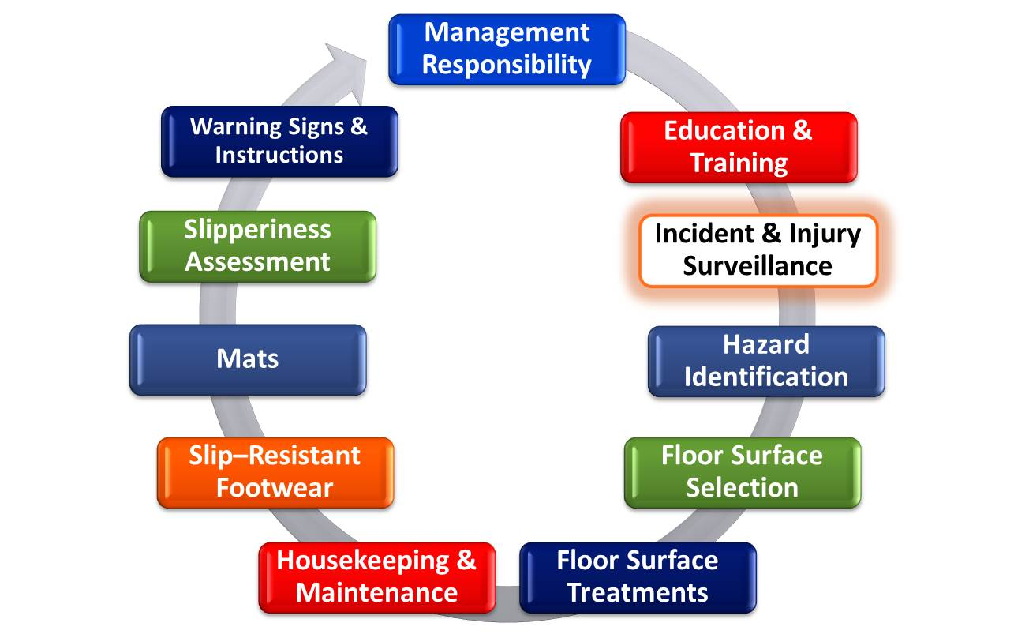
Slip, Trip and Fall Prevention Continuum
Notes:
9
Incident and injury surveillance is first to discuss as is knowing where your problems are. Keep in mind what we see in the insurance world is the very tip of the ice berg. How many of you have slipped but did not fall? How many of you have slipped and fell? How did you feel; embarrassed? Did anyone see you? What did you slip on? Did you do anything about it? Many people slip, some fall, fortunately are not injured, do nothing about the hazard (it remains), do not report it to anyone and move on with their lives. There are hundreds of slips, trips without a fall and slips, trips and falls that go unreported for every claim filed with Liberty Mutual. An organization needs to know their loss trends, where there problems are and take action on prevention. Encourage reporting of incidents even those that do not result in an injury so hazard can be addressed.

Slide 10
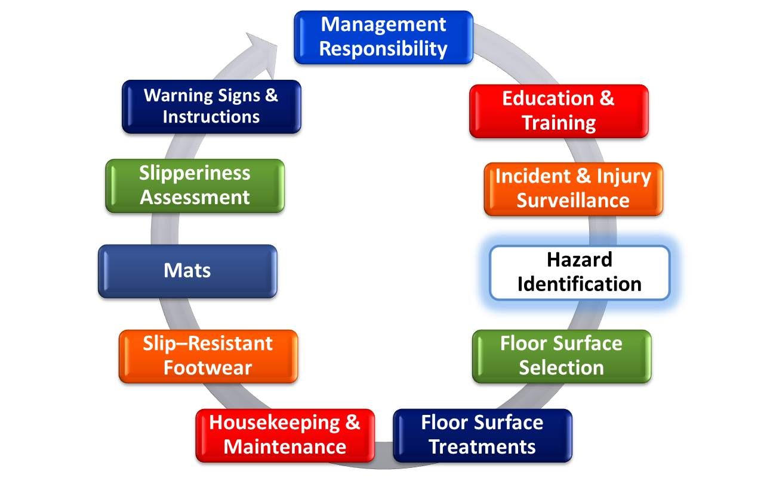
Slip, Trip and Fall Prevention Continuum
Notes:
10
Next lets talk about hazards and common definitions of hazards such as what is slippery? What does slip resistant mean? What is and is not a tripping hazard? We want to spend a lot of time helping you identify slip, trip and fall hazards. Let’s look at tripping hazards first… I think you will recognize many of the exposures we are going to share with you.

Slide 11
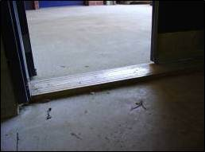
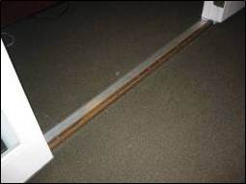
Tripping Hazards
Changes less than ¼ inch (6mm) in height may be without edge treatment
Changes ¼ inch to ½ inch (6mm-12mm) beveled with slop no greater than 1:2 (rise:run)
Greater than ½ inch (6mm) ramp or stairway
ASTM 1637 Standard Practice for Safe Walking Surfaces
US Access Board Technical Bulletin: Ground and Floor Surfaces
Notes:
References are cited in this slide as well as the definition of a trip hazard but, in reality, any raised elevation in the course of pedestrian travel could be a trip hazard and should be avoided.

Slide 12
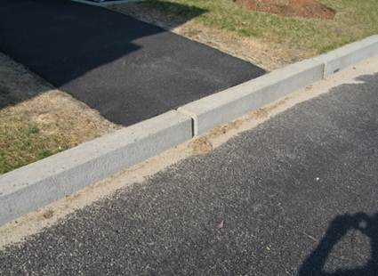
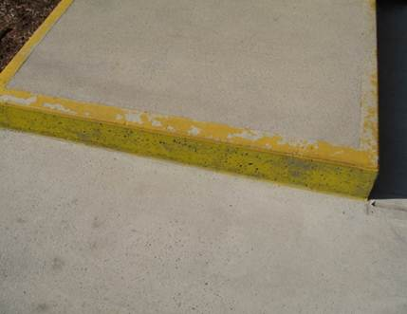

Color and Visual Contrast
ADAAG specifies that detectable warnings "shall contrast visually with adjoining surfaces, either light-on-dark, or dark-on-light”
Surfaces colored safety yellow (ISO 3864, ANSI Z535.1) "most visually detectable“ (US Access Board Research)
Contrast on curbs, step risers, stair nosing and landings
Edge transitions
Notes:
Building owners should be familiar with the ADAAG (Americans with Disabilities Act Accessibility Design Guide) and its requirements. As you can see though, requirements on slip resistance, use of color (other than handicap areas) is left up to the owner and is vague in the standard. According to the US Access Board Research, Safety Yellow is a color even the aged eye can perceive and is why the ADAAG requires handicap entrances be colored Safety Yellow. The ADAAG is only concerned with handicap entrances. No one will tell you otherwise, when and where to use Safety Yellow. In fact, there are no rules, guidelines on mandates on use of any color to improve detection of hazards.

Slide 13
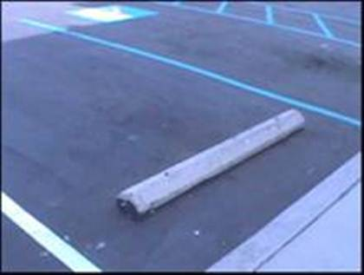
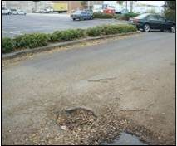

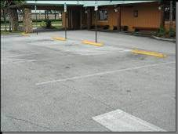
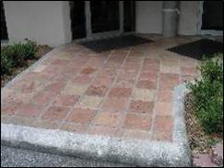
Parking Lots and Sidewalks
Notes:
Examples here are trip hazards and one step elevations that represent significant hazards. As mentioned previously one-step elevations like the sidewalk curb to parking area example and the building entrance example should be remodeled into a ramp entrance following guidelines. In the picture above, this restaurant colored the parking stoppers Safety Yellow to improve visual detection from example on left. Top right picture shows parking lot defects that need repair.

Slide 14
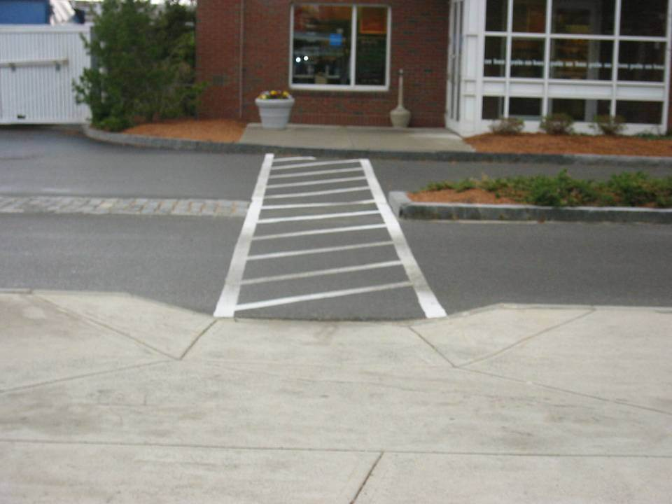
Sidewalk Ramp
Notes:
A good sidewalk ramp in front but when you get to other side, the pedestrian needs to overcome a curb elevation to enter the building. This is an example of poor design. Designers should pre-plan pedestrian travel from parking areas into your building and remove any and all obstacles in the way like unnecessary elevations. This example should have been a sidewalk ramp.

Slide 15
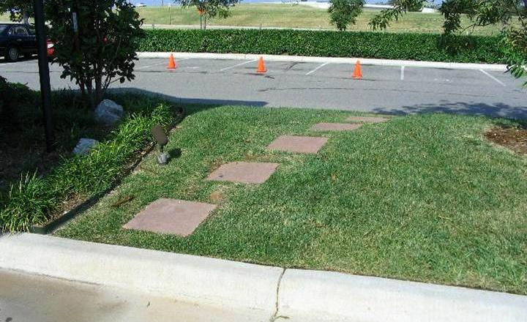
Pedestrian Access
Notes:
Here we have parking areas and pedestrians overcoming a curb on both sides to enter the building. What would be the best solution here? Sometimes we actually see hedges in the way and pedestrians trying to take a shortcut through the hedge. Again, pre-plan pedestrian access to your buildings and eliminate obstacles.

Slide 16
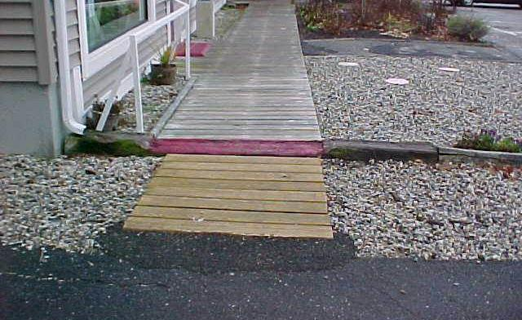
Elevations
Notes:
Here we have raised elevations from parking areas, to wood walkway, to store entrance. I count three obstacles. Notice the building owner chose the color red to warn people. Red is not visually detectable for those with color blindness or red color deficiency and does not provide sufficient color or brightness contrast. Notice the gutter downspout drainage right over the creosoted railroad tie that provides an interesting obstacle on wet/snowy days. This whole design was completely redone and all trip hazards were removed.

Slide 17
Slips and Falls on Stairs
Defects
  Inadequate lighting
  Inadequate stairway visibility
  Inadequate or no handrail
  Handrail at improper height
  Improper tread or riser dimensions
  Tread visibility or surface material
Faulty housekeeping
  Objects, water, or grease on stairs or landings
Notes:
Notes to Instructor/Facilitator
Discuss the factors that can lead to falls from stairs.
______________________
Discussion Leader’s Notes:
Falls from stairs occur largely because of stair defects, debris or liquid on the steps. Many of these hazards can be controlled, if the stairs meet the industrial stairway requirements and they are kept in a clean, dry condition.

Slide 18
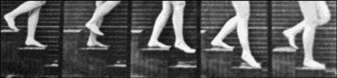
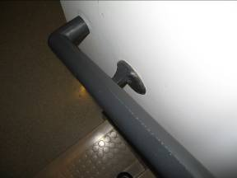
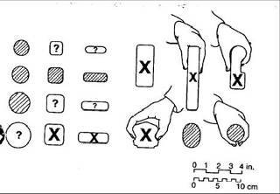
Stairways / Handrails: Falls and Causes
Stairways: Missteps/loss of balance
  Over step, under step, air step
Handrails: Both sides of stairs, full length of stair
Notes:
It is important to understand how falls occur on stairways. They are sometimes called stumbles but are known best as missteps. The three types of missteps include; an under-step when the heel strikes the riser on descent, an over-step when the ball of the foot rolls off the tread nosing (depicted here) and an air-step when the pedestrian misses the tread all together. Many reasons why these missteps can occur with some due to stair design (riser/tread dimensions, stair too steep etc) and some due to pedestrians running down stairs or carrying items. Either way, the handrail is the only thing separating the pedestrian from certain injury or worst and the availability and design must be taken seriously.
The guidelines here are common guidelines in the building codes, ADAAG (where this image came from), NFPA 101 Life Safety Codes on hand rail design etc. A handrail is not useful if it cannot be gripped and the dimensions here offer good guidance. Decorative handrails like the examples with “X” are “not recommended” but yet we see them all the time. If you need to replace or add handrails, please use a style more conducive to better grip effect.

Slide 19
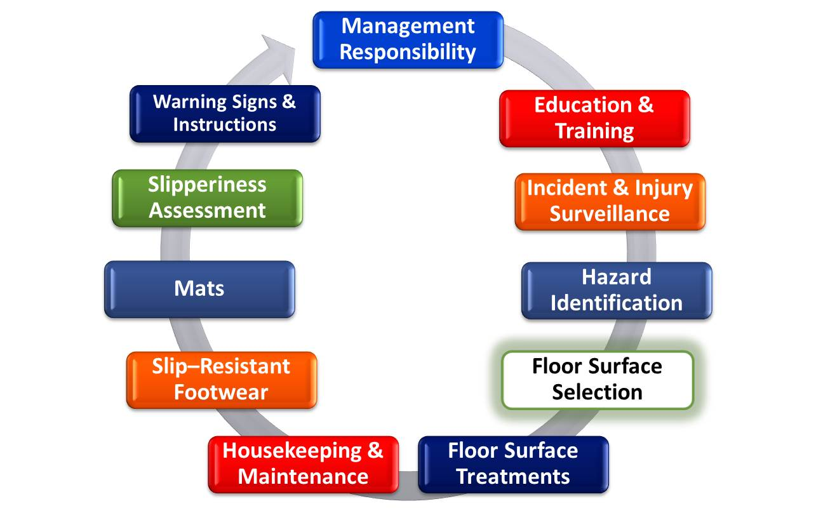
Slip, Trip and Fall Prevention Continuum
Notes:
Next is floor surface selection

Slide 20
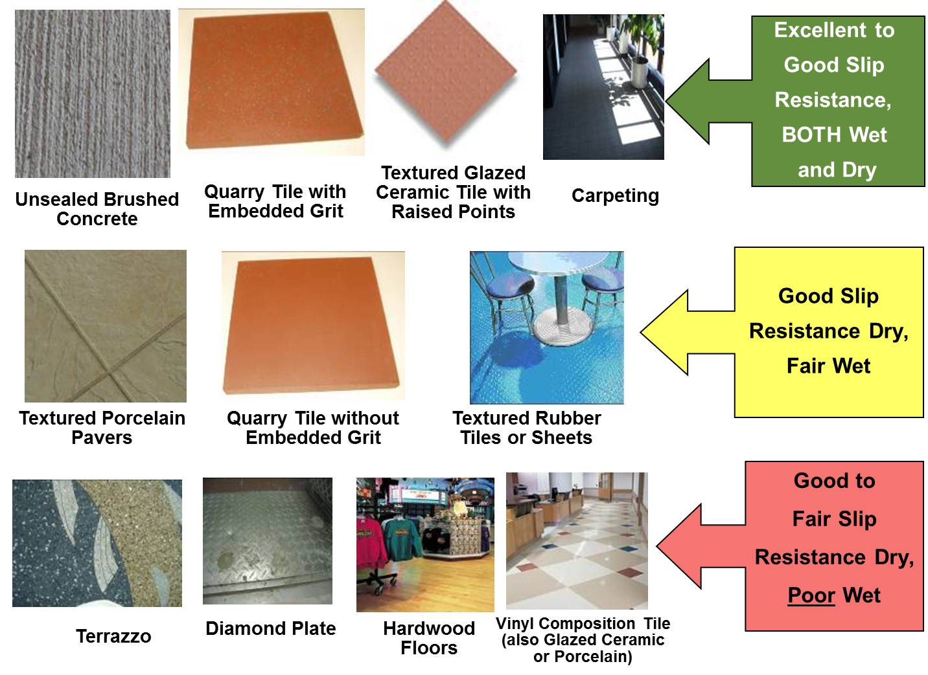
Notes:
Not all flooring is not created equal and some products perform differently in terms of slipperiness. If you have a floor that you expect to be exposed to wet conditions, like at entrances or in manufacturing operations where water or contaminants are present like oil, grease, dust, etc. then consider a product that will perform well from a slip resistant standpoint. Otherwise, you are dealing with entrance mat strategies and housekeeping to keep floors clean and dry. You might also be talking about treatment interventions which we will talk about in a minute.

Slide 21
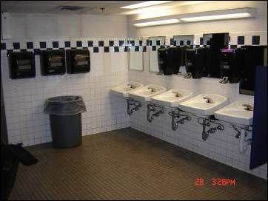
Additional Considerations
Restrooms
  Soap dispensers by sink
  Paper towel dispensers by sink; not behind
Cafeteria
  Same as above
  Housekeeping; spill control
  Floor cleaning protocol
Notes:
This slide speaks to the importance of placement of towel dispensers and hand dryers after washing hands in rest rooms. When remodeling your rest rooms discourage them being placed where the pedestrian drops water from their hands onto the floor to access them. Ideally, keep in front or near the sinks.

Slide 22
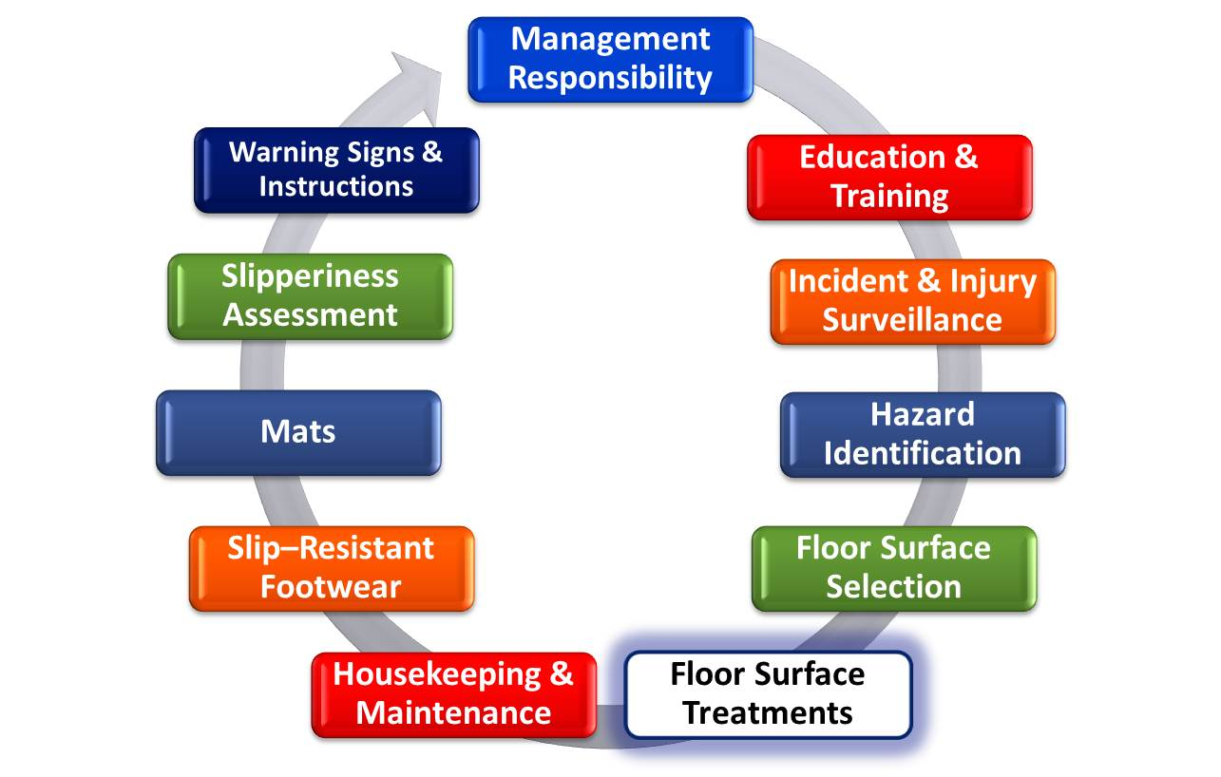
Slip, Trip and Fall Prevention Continuum
Notes:
Next are some brief comments on floor surface treatments to improve slip resistance of floors and some facts about manufacturer slip resistant lab test results provided in the product specification sheets.

Slide 23
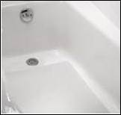
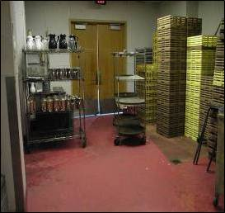
Treatments
Chemical etching
  Ceramic tile, quarry tile, natural stone, porcelain (including bathtubs), concrete
  Ammonium Bifluoride (AB)
Waxes, polishes
  Limitations of COF data offered by manufacturers
  Durability an issue
Coatings (acrylic, urethane)
  Grit issues similar to epoxy discussion
  Self adhesive mats (plastic, fiberglass bathtubs)
Notes:
Most common treatments are etches, waxes and polishes and slip resistant products to add to wash water, wax and polishes and coatings. Each one has advantages and disadvantages. Chemical etches are only effective for clean water not grease or oil contaminants. Ammonium Biflouride (AB) is a common chemical etching material. Etching treatments are common in bath tub treatments and non-glazed tiles as indicated. The benefit is a micro surface roughness treatment but they do wear over time and sometimes need to be redone.
Waxes and polishes and slip treatments offer limited benefit when wet and mostly the benefit is seen when dry. We’ve seen this in the field and in the laboratory.
This ASTM standard and UL 410 standard and slip test is a laboratory test frequently performed by manufacturers of waxes and polishes and results are cited in their specification sheets. They often certify their product as “slip resistant” from this lab test but they don’t tell you the test is a dry only test and is NOT a measure of wet slip resistance, which is what we are more concerned about for slips and falls. For all practical purposes, this test offers very limited information on slip performance.
Coatings offer a more durable treatment and there are 3 types; urethane, epoxy and acrylic. You can blend in grits as well. It is important to mention you can get very good slip resistance from very small grits and there are grit size recommendations for industries including food processing.

Slide 24
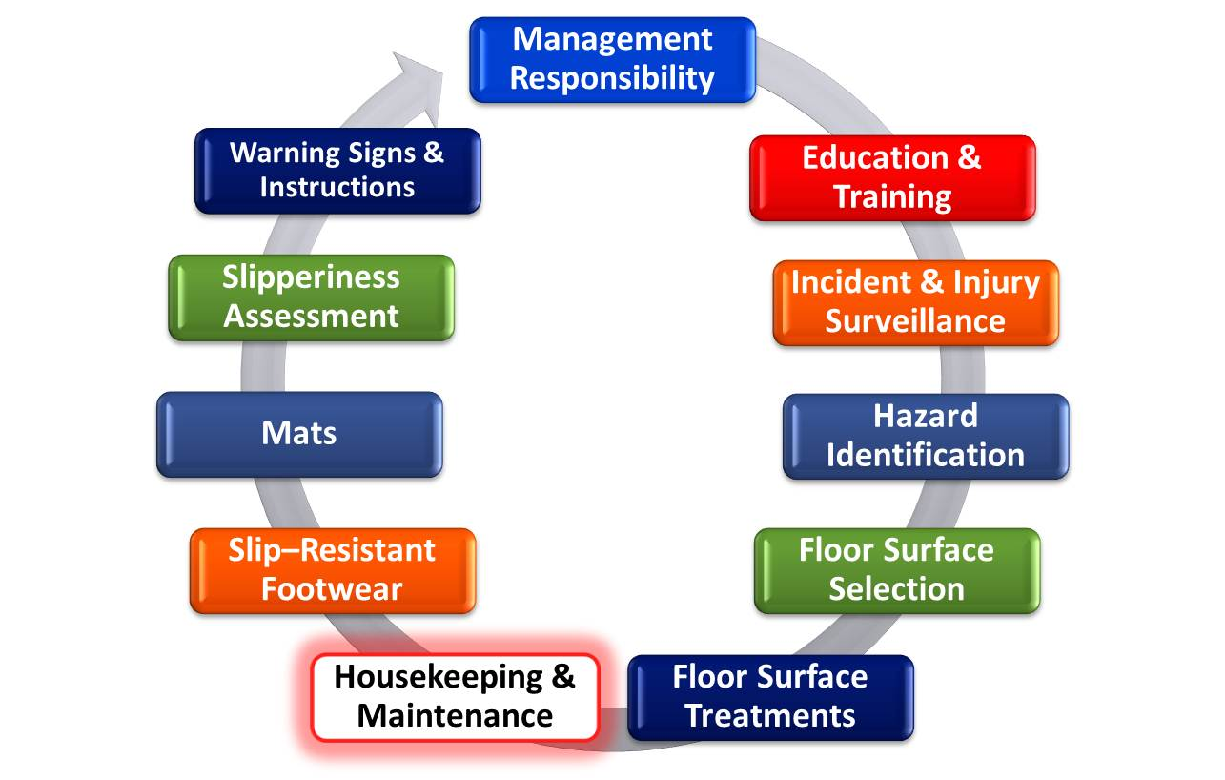
Slip, Trip and Fall Prevention Continuum
Notes:
Now lets talk about housekeeping and importance of floor cleaning protocols.

Slide 25
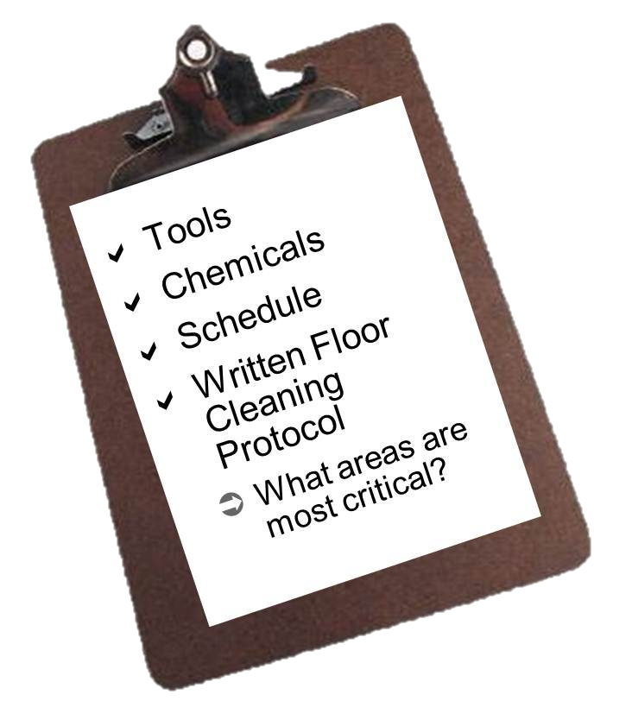
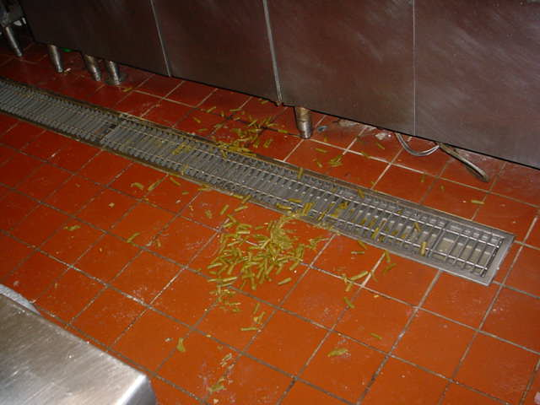
Housekeeping: Floor Cleaning
Notes:
One of the most important prevention elements is managing the housekeeping and cleaning process of your floors. Selecting the right floor cleaning chemical for the desired contaminant is critical to keeping the floors clean. You need to ensure you follow the manufacturer’s instructions on concentration mix, water temperature, dwell time and rinse. Too much cleaner will leave a residue which can be slippery, too little won’t clean the floor adequately. In the case of enzymatic cleaners, the manufacturers say not to use hot water and rinse and more in a second on that. Your floor cleaning protocol should be in writing and managed with the frequency schedule. Having the right cleaning tools available is important as well; mops, buckets, rinse equipment etc. Liberty Mutual recently completed a study of slips and falls in the limited service restaurant industry and commonly discovered restaurants were not following instructions for use of enzymatic floor cleaners. This same study concluded that for every 0.1 increase of a floors mean COF there was a corresponding 21% decrease in slips reported by workers. Your floor cleaning method can contribute greatly to increasing the COF of your floor.

Slide 26
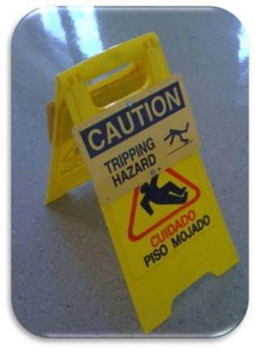
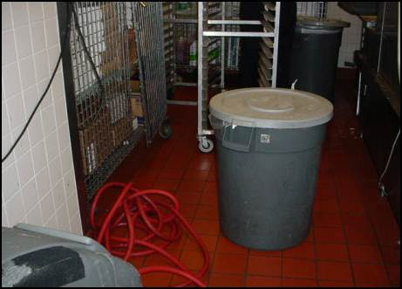
Housekeeping Controls
Education (signs)
Enough trash containers
Accountability for falls hazard prevention
Notes:
Notes to Instructor/Facilitator
Discuss the elements of a housekeeping program.
______________________
Discussion Leader’s Notes:
Placing warning signs around wet floors to warn pedestrians of potential slippery hazards is an appropriate intervention but warning signs should be promptly removed when the hazard is corrected. Some of these signs can actually become tripping hazards if they are there too long. Having enough trash containers available is important as well to keep floors free of debris.

Slide 27
Measuring Housekeeping
Hold first line supervisors accountable for cleanliness in their departments
Floor hazards must be periodically sampled, recorded and information fed back to managers. (Unannounced inspections)
Floor cleaning protocols must be tailored to the environment and floor material
Educate employees on the importance of “clean as you go”.
Notes:
Notes to Instructor/Facilitator
Discuss the ways to make housekeeping accountable at each level.
______________________
Discussion Leader’s Notes:
Establish a training program for persons responsible for inspection, maintenance, and cleaning. This includes definition of cleaning requirements, cleaning procedures, safe handling and disposal of chemicals and solutions, emergency conditions and operations, and record keeping or reporting related to housekeeping and maintenance. The importance of “clean as you go” policies are important as well i.e. “if you see it pick it up or clean it up”. Good housekeeping is everyone’s responsibility.

Slide 28
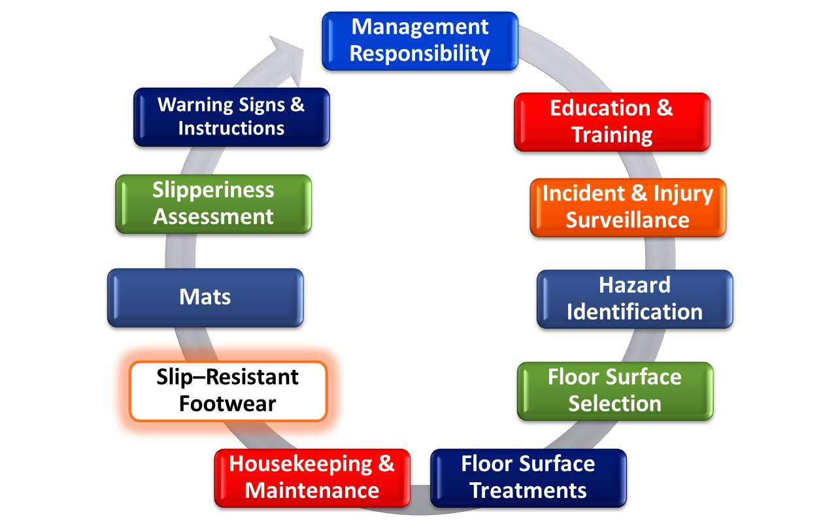
Slip, Trip and Fall Prevention Continuum
Notes:
Let’s briefly talk about slip resistant footwear

Slide 29
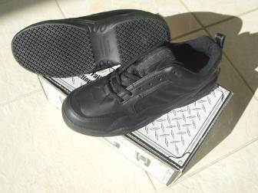
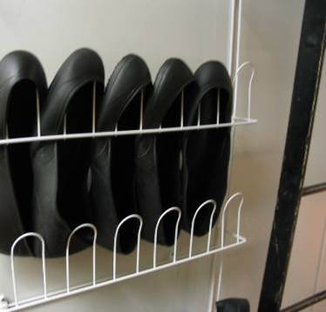
Slip-Resistant Footwear
No universal standard on what is slip-resistant
  Look for “Slip Resistant” on the shoe itself or on the box/descriptive literature
  “Oil-Resistant”, “Non-Marking”, “Skid-Resistant” are not the same!
Tread material
  Softer rubber outsole conforms to floor surface
Tread design
  Large contact area (no large gaps between contact surfaces)
  Lots of crisscrossing grooves.
Overshoes are available
Notes:
Slip resistant footwear is primarily used in food service operations and in healthcare. Manufacturers follow general guidelines as shown on this slide for outsole rubber materials and tread design that increase slip resistance performance of the shoe. Overshoes are also available at reduced cost. New standards are being written on slip testing of footwear but, at the moment, manufacturers of slip resistant shoes do their own testing and do not follow a standard test method. Regardless, the same Liberty Mutual limited service restaurant industry study mentioned previously had also shown use of shoes marked as slip resistant resulted in higher mean COF and were associated with a decreased rate of slipping. General guidelines for workplace footwear and slip resistance is that the tread should be in good condition and offer good slip resistant benefits.

Slide 30
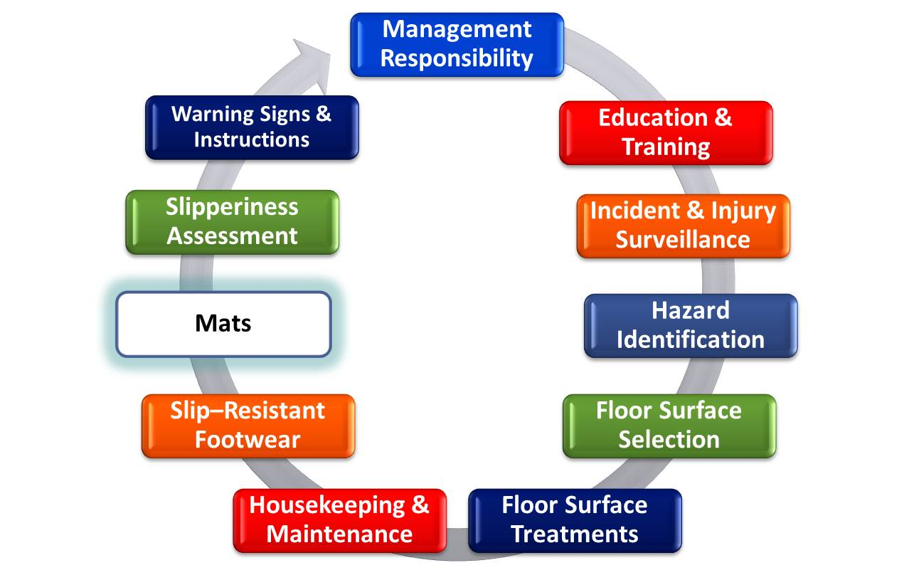
Slip, Trip and Fall Prevention Continuum
Notes:
Now lets talk about mats. The discussion on here is mostly on entrance mats.

Slide 31
Entrance Mat Criteria
Sufficient running length and width (unpublished manufacturer’s study)
  Snow: 10 - 12 walking steps or 25 to 30 feet
  Rain: 8 - 10 walking steps or 20 to 25 feet
  Dry: 6 - 8 walking steps or 15 to 20 feet
80% of soil entering a building can be trapped within the first 15’ on a carpeted surface
Designed and placed so as not to create additional fall hazard
Rule of Thumb: should not be able to see footprints after stepping off mat (wet)
Notes:
31
Some floor surfaces by design are very slippery when wet and they include: waxed/polished VCT, smooth glazed ceramic and porcelain, waxed polished rubber, terrazzo, and polished natural stone such as granite, marble and engineered stones such as quartz. Mats are designed to remove water and soil from footwear but design and function of mats is often neglected or not considered. The mat running length recommendations are based on unpublished research and are general guidelines but make good sense for various weather conditions.

Slide 32
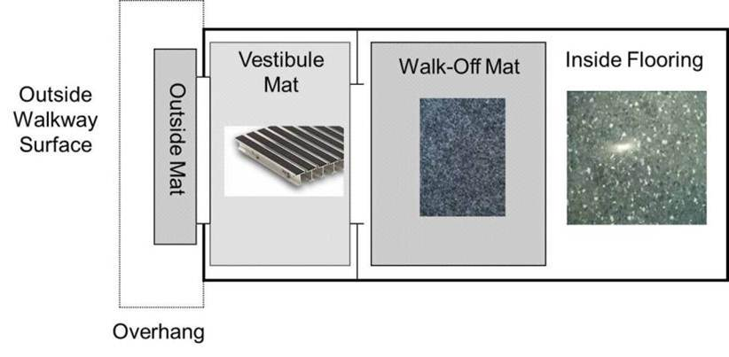
Entrance Mat Strategy
Notes:
32
Here’s a look at an entrance strategy using various components to get the foreign debris and water off the shoes. When you do not have outside mats and/or vestibule mats, the inside mats need to work harder, therefore need to be longer and cleaned more often.

Slide 33
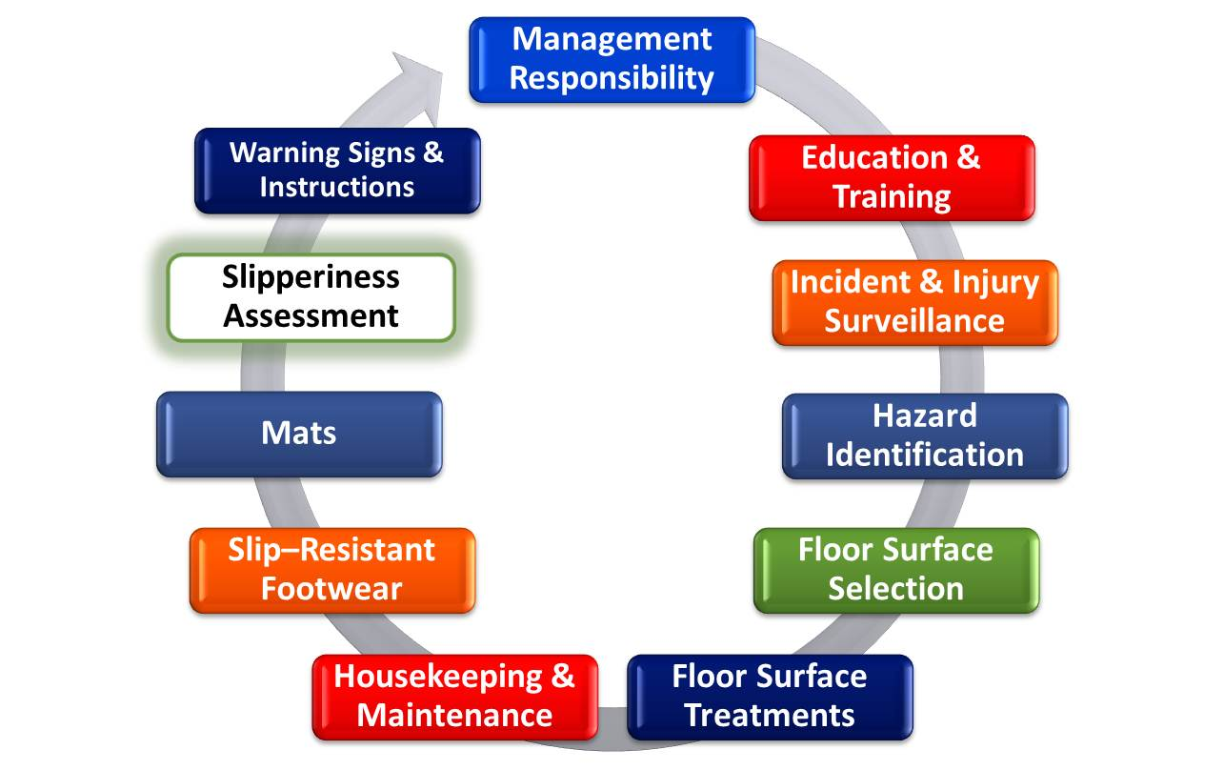
Slip, Trip and Fall Prevention Continuum
Notes:
Now let’s briefly look at methods for measuring the slip resistance of floors.

Slide 34
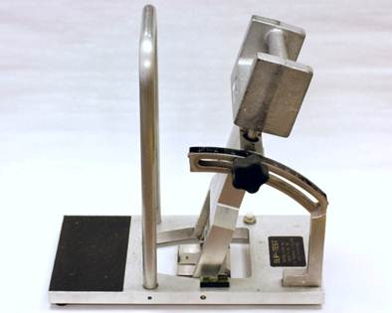
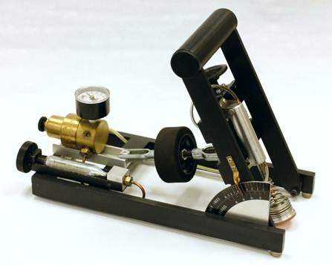
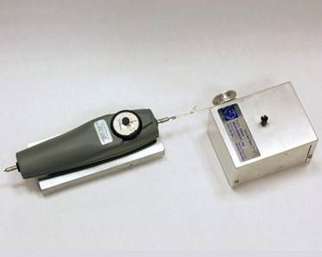
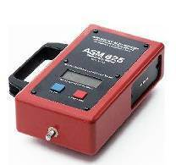
Slipmeters or Tribometers
Brungraber Mark II (PIAST)
English XL (VIT)
Horizontal Pull Slip Meter (HPS)
ASTM F609
American Slip Meter, Inc
Notes:
There are a number of different slipmeters or tribometers used by safety professionals, flooring and treatment manufacturers and forensic professionals to measure the slipperiness of floors and therefore determine likelihood of a slip and fall. Each of these devices has advantages and disadvantages when collecting a dry versus wet measurement. Liberty Mutual uses the Brungraber Mark II slip meter and if this is an area of interest for you, please contact Liberty Mutual Loss Control Advisory Services for further information.

Slide 35
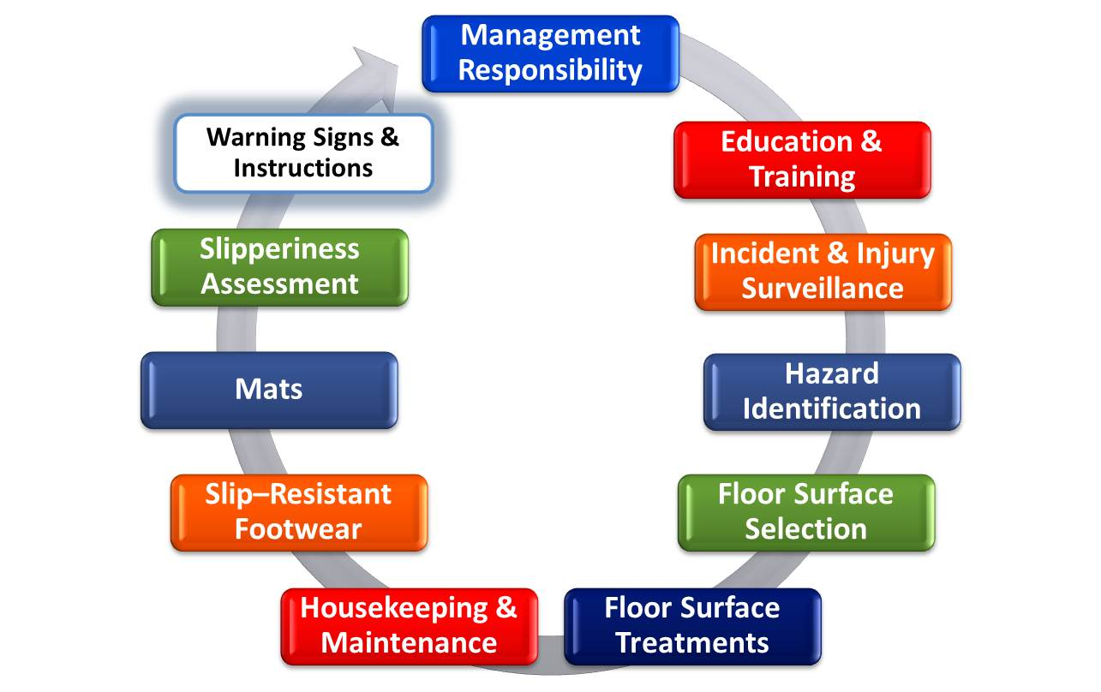
Slip, Trip and Fall Prevention Continuum
Notes:
Next some comments about warning signs and instructions…

Slide 36
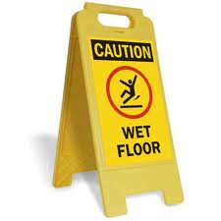
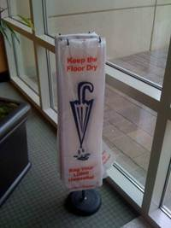
Warning Signs and Instructions
Wet floor signs are needed – but need to be removed when hazard no longer exists
  Empower everyone in your influence to place these signs up whenever needed.
Umbrella bags are helpful and offer additional instructions to tenants and visitors
Notes:
Wet floor signs are helpful, but not if they are used too often. They can actually represent a trip hazard if left in place long after the floor is dry so remove them when the floor is dry. We want to empower everyone in your influence to place these signs up (and take them down) whenever needed. Umbrella bags at entrances are helpful and offer additional instructions to tenants and visitors.

Slide 37
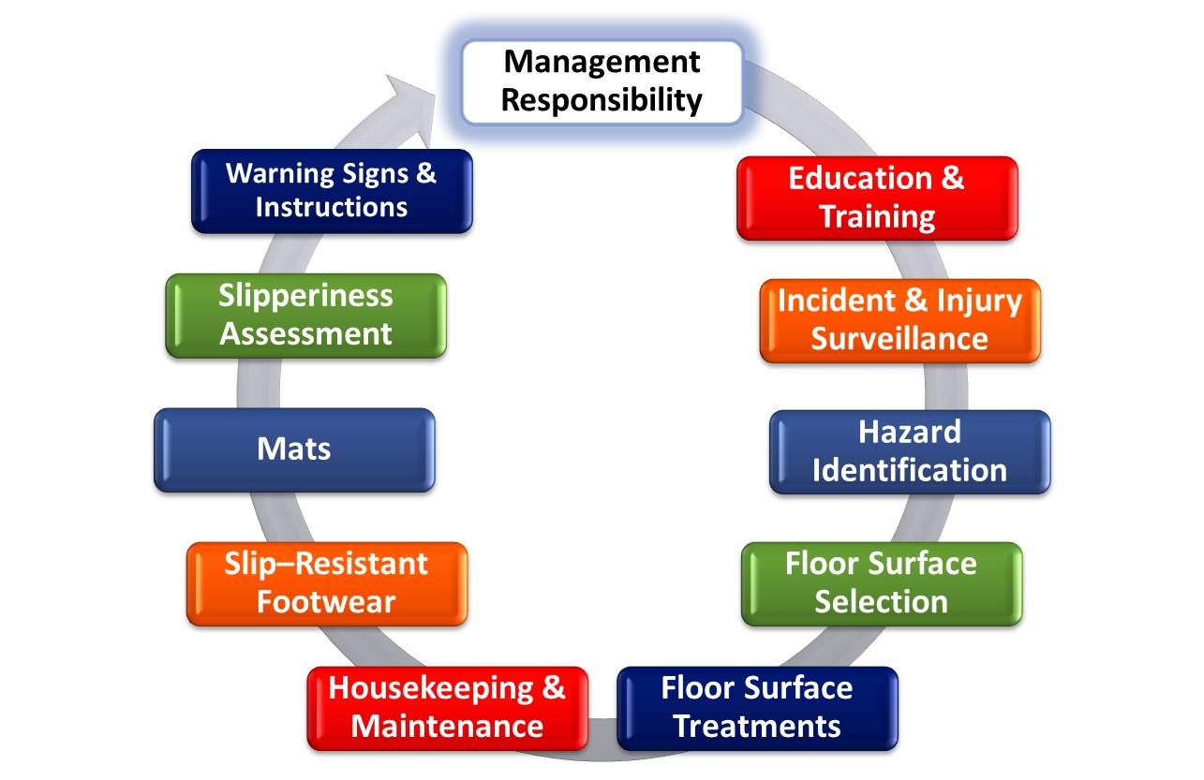
Slip, Trip and Fall Prevention Continuum
Notes:
Management has the responsibility of setting performance expectations for slip, trip and fall prevention and supporting proactive initiatives to prioritize slip, trip and fall prevention into facility design and flooring standards in addition to cost and aesthetics.

Slide 38
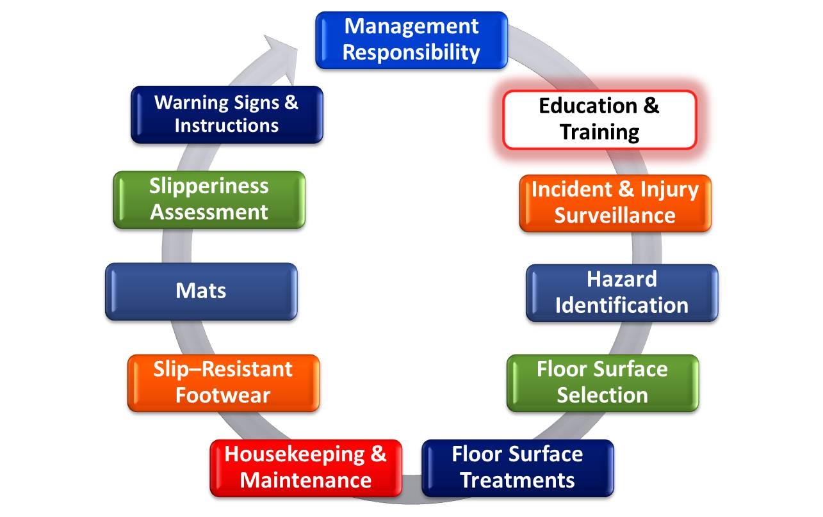
Slip, Trip and Fall Prevention Continuum
Notes:
We’ll end the session with the importance of training all major stakeholders and thus the importance of this webinar. Education and training is important such that all in the organization understand their role in preventing slips, trips and falls including architects, design and construction, facility managers, maintenance and housekeeping, HR, safety, and employees. Training sessions like this is a good start.

Slide 39
Summary
Same level falls continue to be a serious problem both in the workplace and public places.
Understanding slip, trip and fall causes and contributing factors is very important to prevention.
Slip, trip and fall prevention requires participation from multiple stakeholders that address multiple elements in a fall prevention process.
Identify and prioritize where your opportunities are and implement appropriate corrective action.
Notes:
In summary, same level falls are a serious and growing problem. Prevention starts with understanding causes of falls and applying a systems approach that involves everyone in the organization. This includes employees reporting incidences and close calls as well as enforcing clean as you go policies. As a result of this session identify where your opportunities for improvement are and anytime you have questions please contact Liberty Mutual Loss Control Advisory Services as we are here to help you.

